Slide 1


Final Project
Honda Cars
Scripting for Data Analysis - IST 652
Kelsey Kirby
Sean Deery
Mark Stiles
June 7, 2023

Slide 2

Agenda
Dataset
Data Cleaning
Exploratory Data Analysis
Price Analysis
Conclusion

Slide 3
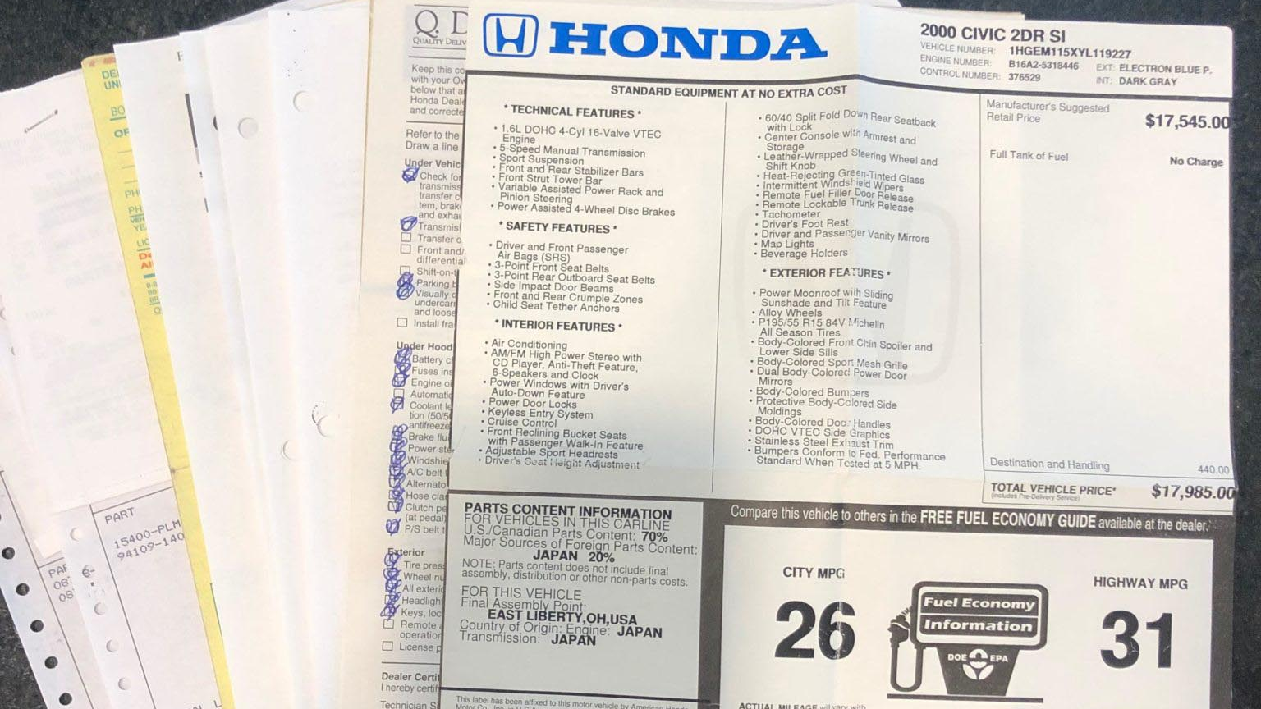
Background Information
Cars.com
Current Sales
Time Bias
Rating Bias
Hand Corrected Values
Partial Summary of the Report

Slide 4

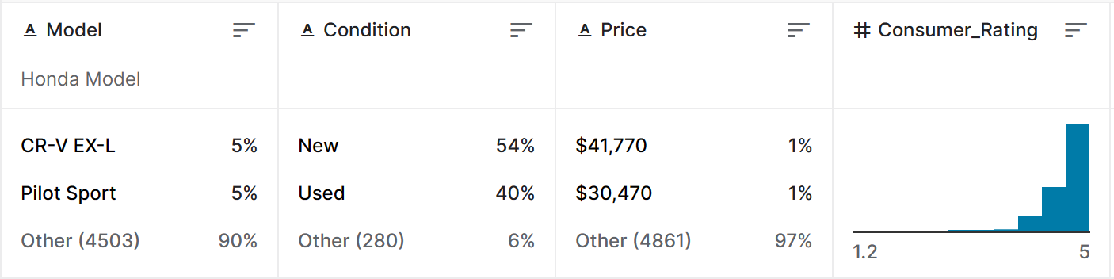
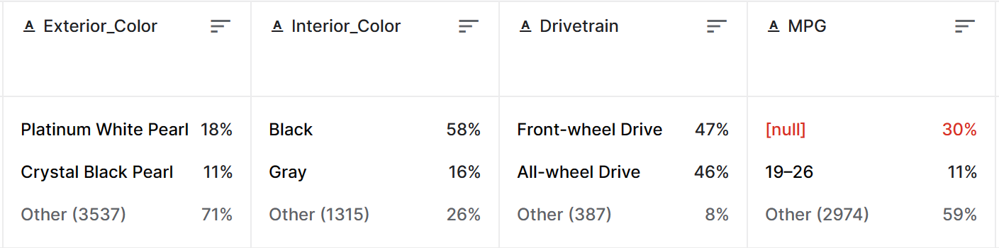
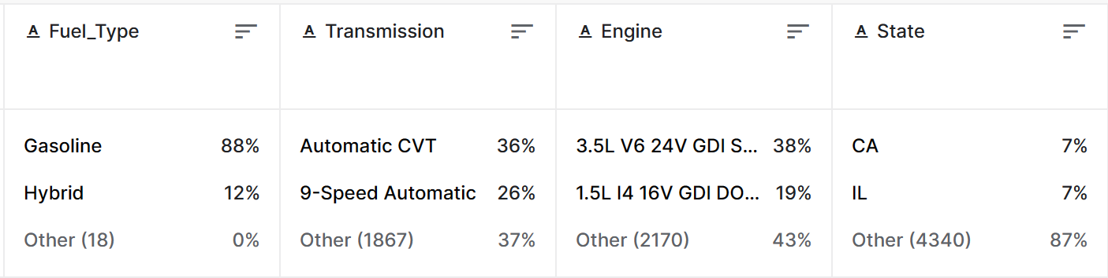
https://www.kaggle.com/datasets/omartorres25/honda-data
4,999 Observations x 25 variables
Focus on:
Numeric
Price
Consumer Rating
MPG
Mileage
Year
Categorical
Model
Condition
Color
Drivetrain
Fuel Type
Transmission
Engine
State
Notes:
This Kaggle dataset is about Honda car sales scraped from cars.com. Cars.com is now the second-largest automotive classified site with a large collection of vehicles for sale. However, the website can be prolonged, and to collect many Honda vehicles to help me choose between economical cars I build a web scraper to collect up to 5,000 Honda vehicles. It is expected to be updated quarterly. This dataset was last updated two months ago.
Additional categories we looked at that are not mentioned are consumer rating, comfort rating, interior design rating, performance rating, value for money rating, and reliability rating.
Most of the cars in the dataset were sold by dealers.

Slide 5

Data Cleaning

Slide 6

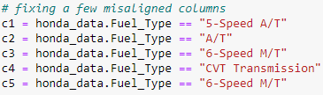
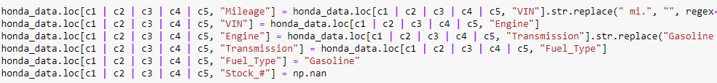
Column Cleanup

Slide 7
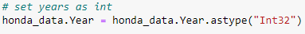
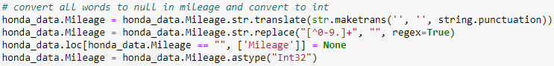
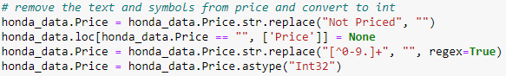
Number Cleanup

Slide 8
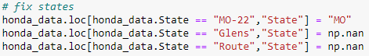
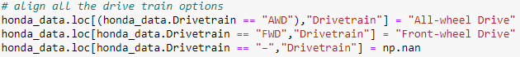
Category Cleanup

Slide 9

Variable Construction

Slide 10
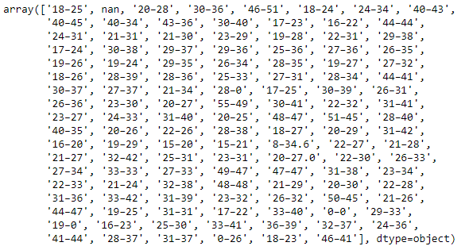
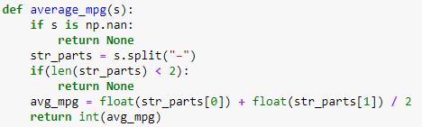
Average MPG Variable

Slide 11
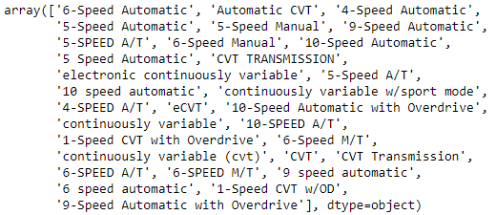
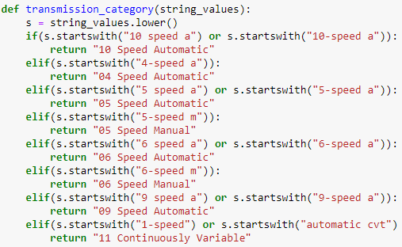
Transmission Variable

Slide 12
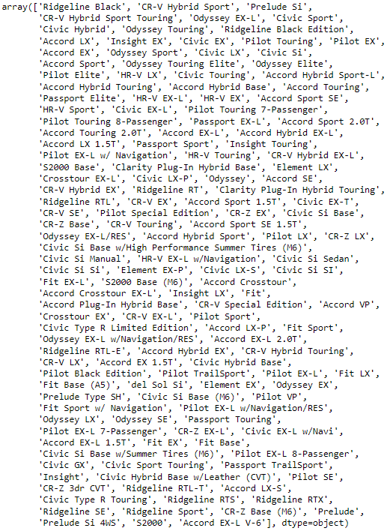
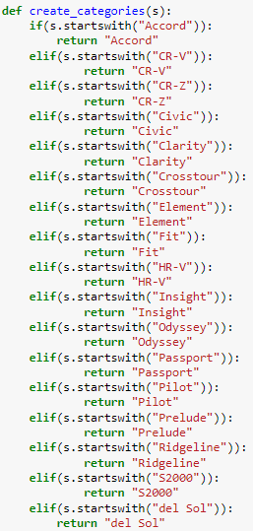
Model Category Variable

Slide 13
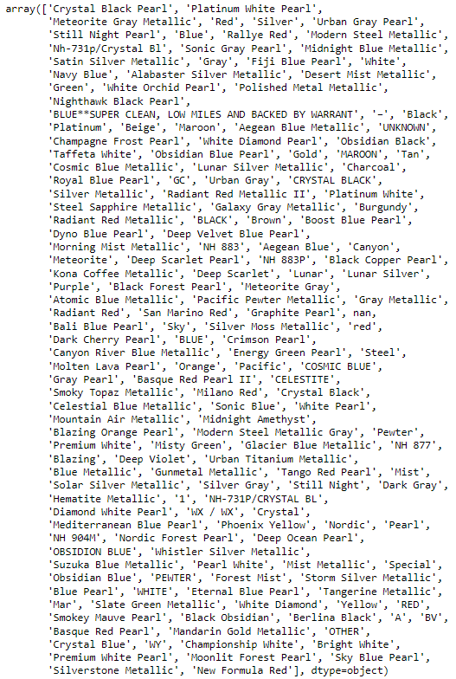
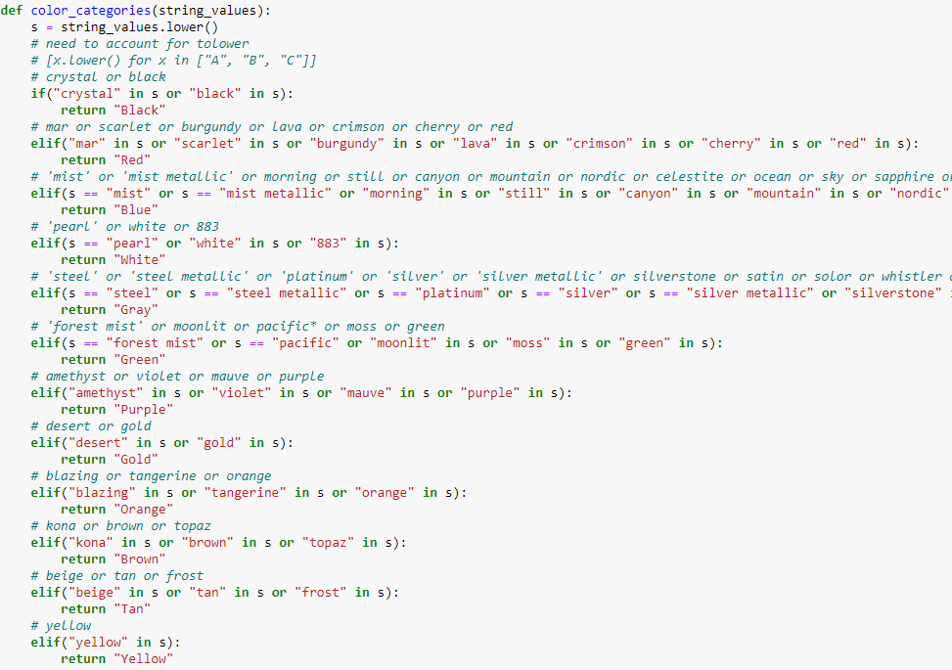
Color Category Variable

Slide 14
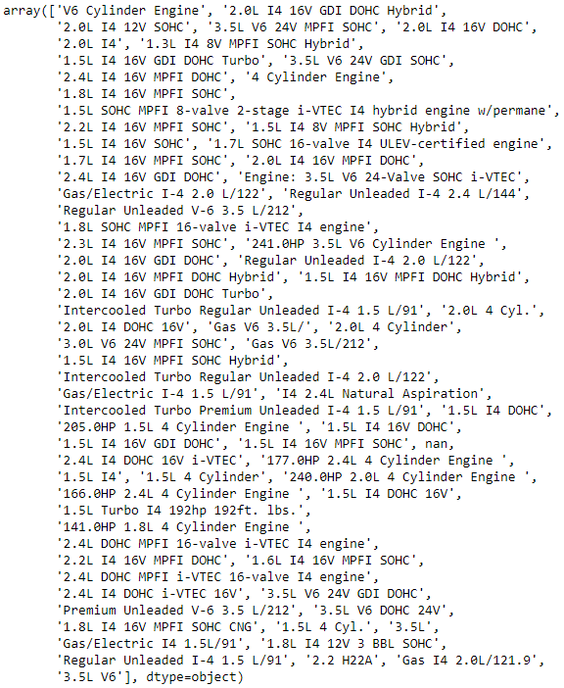
Engine Variables

Slide 15
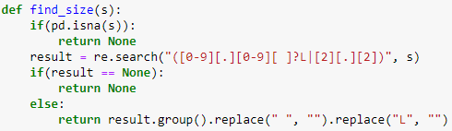
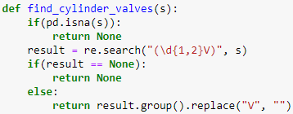
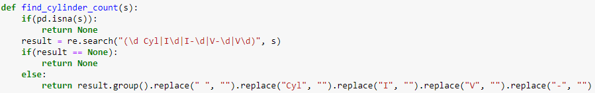
Engine Variables

Slide 16
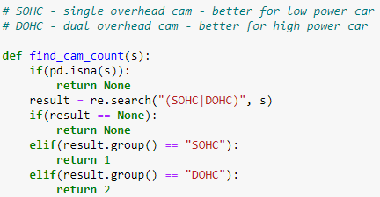
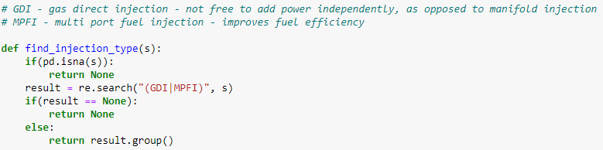
Engine Variables

Slide 17
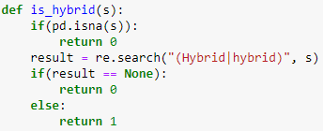
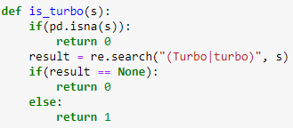
Engine Variables

Slide 18
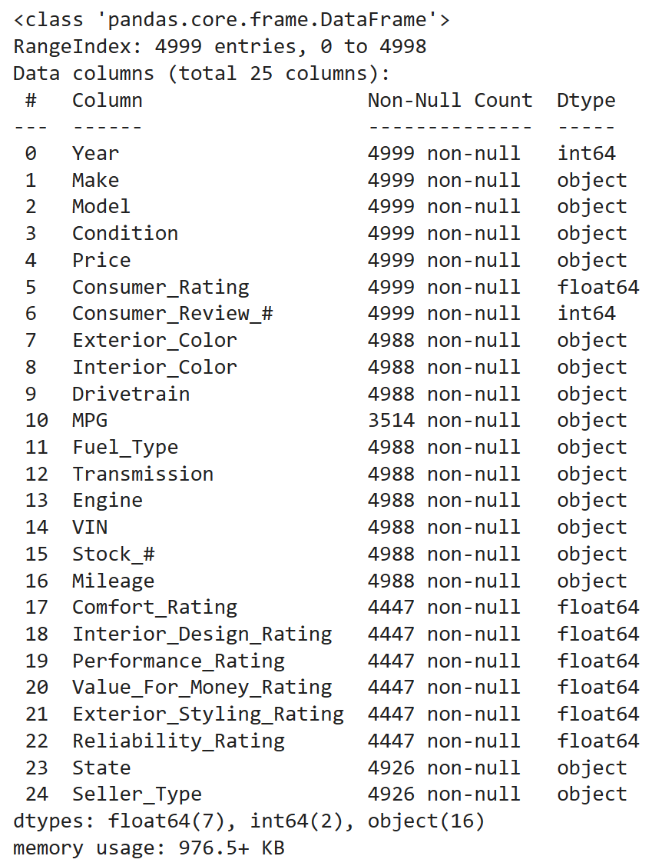
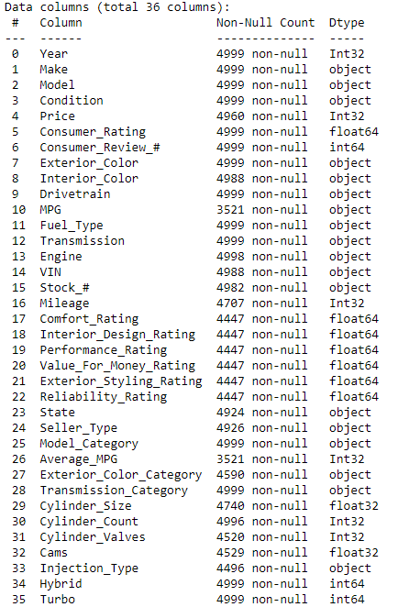
Cleaned Data

Slide 19
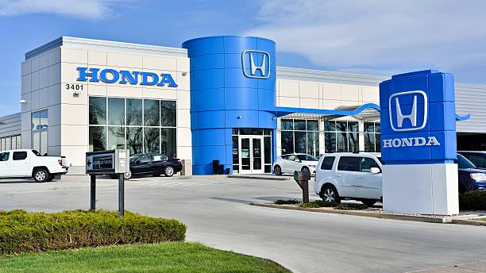
Exploratory Data Analysis

Slide 20
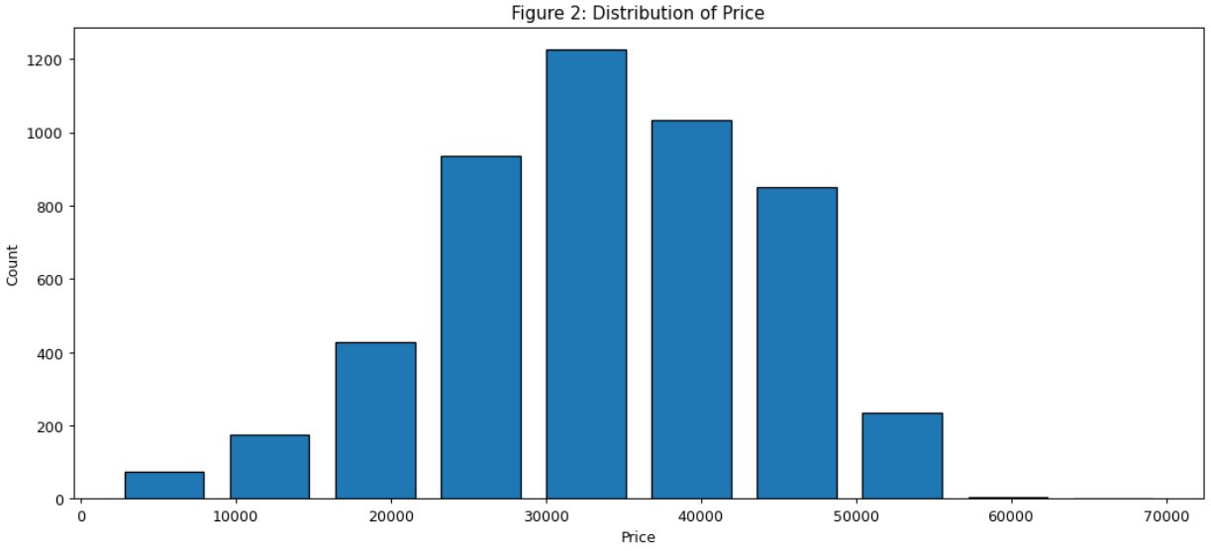
Distribution of Price
Notes:
Figure 2 shows a mean near $35,000 with a low in the single thousands up to just over $60,000. It’s normally distributed and gives some shape to the range of new and used Honda car values.

Slide 21
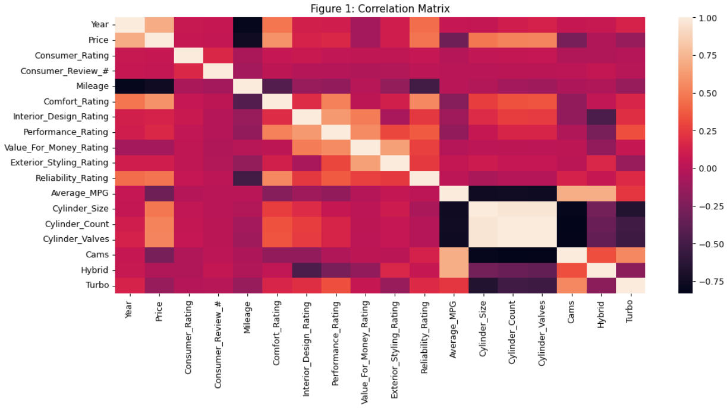
Correlation Matrix
Notes:
The correlation matrix shows the correlations between the numerical variables. White represents positive correlations, black represents negative correlations, and pink represents no correlation. Looking at Price you can see that some of the columns that are correlated with Price include Mileage, Year, Comfort Rating, and the number of Cylinders in the engine.

Slide 22
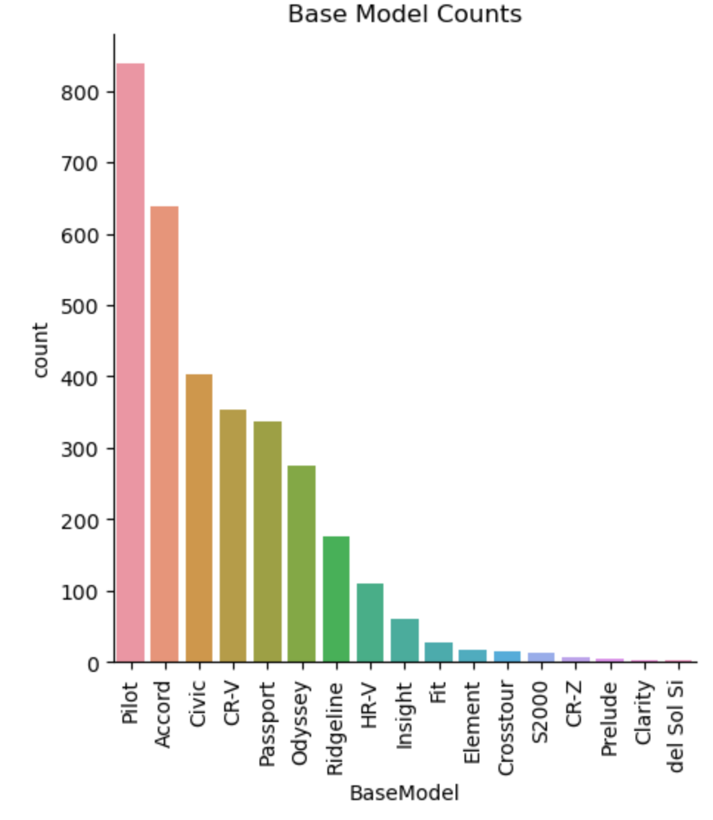
Base Model Count
Notes:
This count plot of the base models shows what kinds of cars were in the data set. Many of the cars were the Honda Pilot, Accord, Civic, and CR-V.

Slide 23
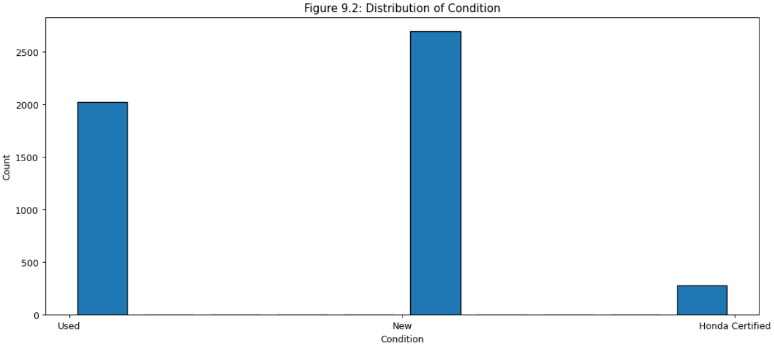
Condition Count
Notes:
This count plot of the condition shows the majority of the cars are new but it is almost split between new and used or certified. Honda certified cars are used but they go through inspection and come with some extra benefits for the buyer.

Slide 24
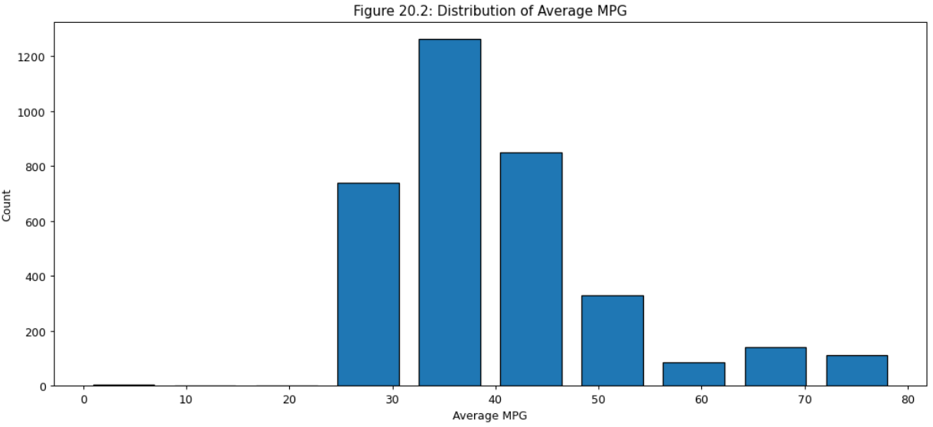
MPG Count
Notes:
This histogram shows the distribution of the average MPG for each car. The mean is 40 and the median is 33, with some outliers on the high end. The max MPG is 79.

Slide 25
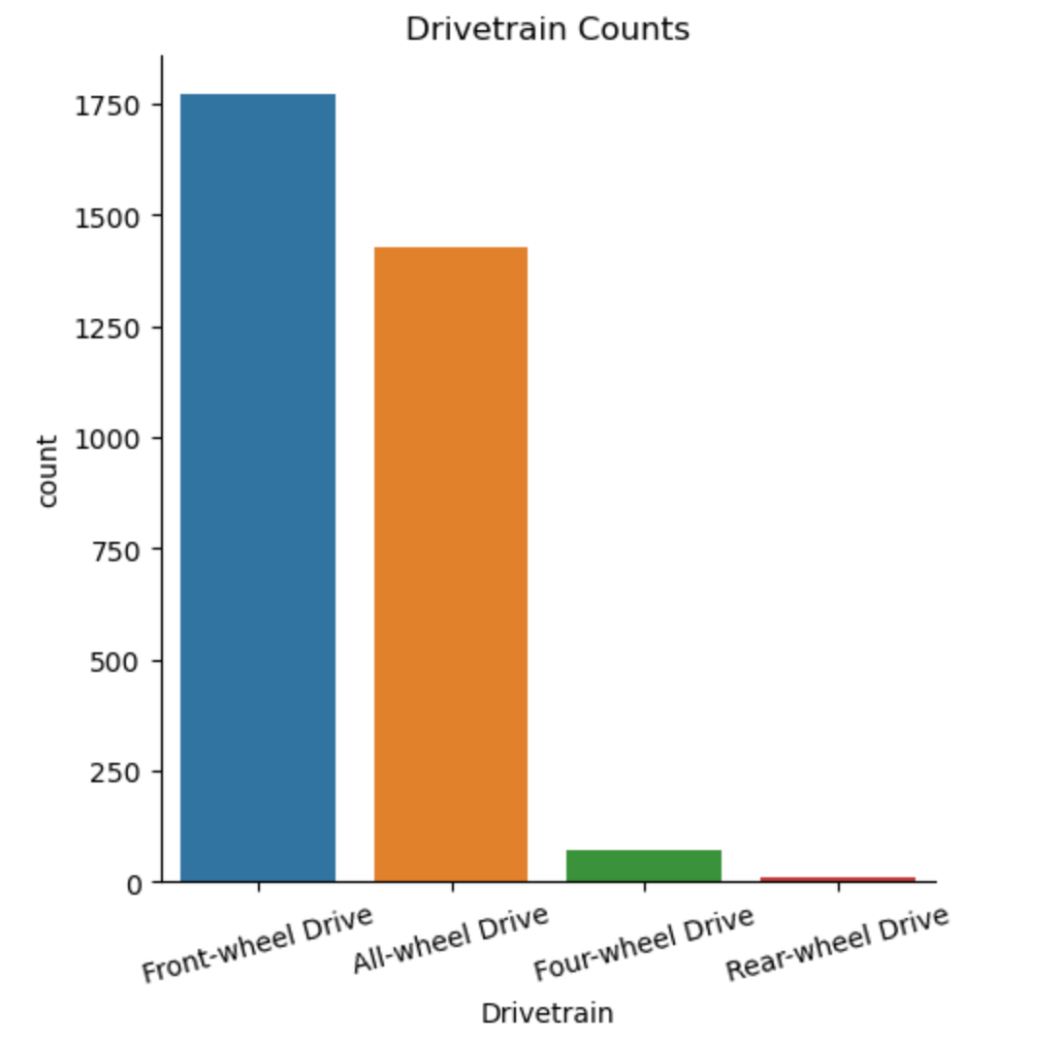
Drivetrain Count
Notes:
This bar plot shows the distribution of the different drivetrains. Front wheel drive took up about 54% of the dataset and all wheel drive 43%. There were very few cars with four-wheel drive or rear-wheel drive.

Slide 26
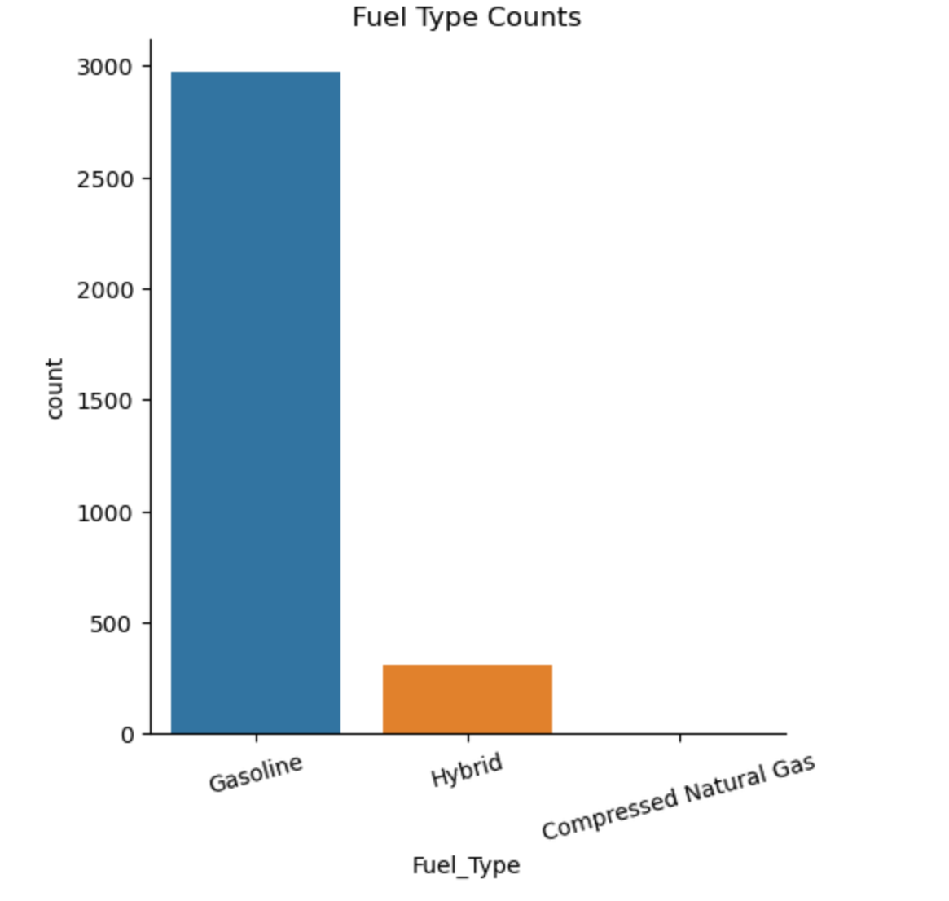
Fuel Type Count
Notes:
For fuel type, gasoline took up about 91% of the dataset and hybrid 9%. There was 1 car that used Compressed Natural Gas.

Slide 27
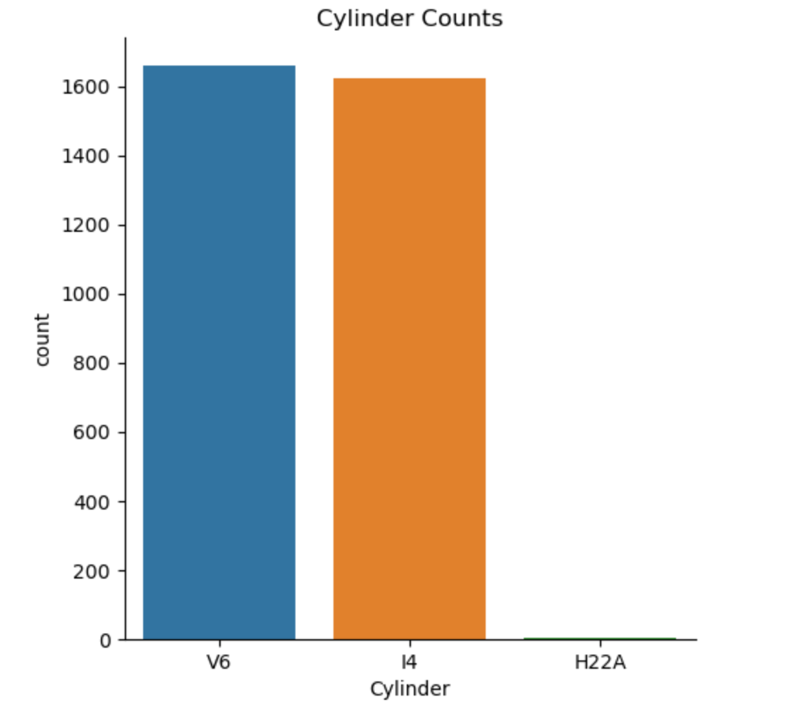
Cylinder Count
Notes:
This bar plot shows that the cylinders were about evenly split with there being a couple cars that used an H22A, which I believe is another type of a 4 cylinder.

Slide 28
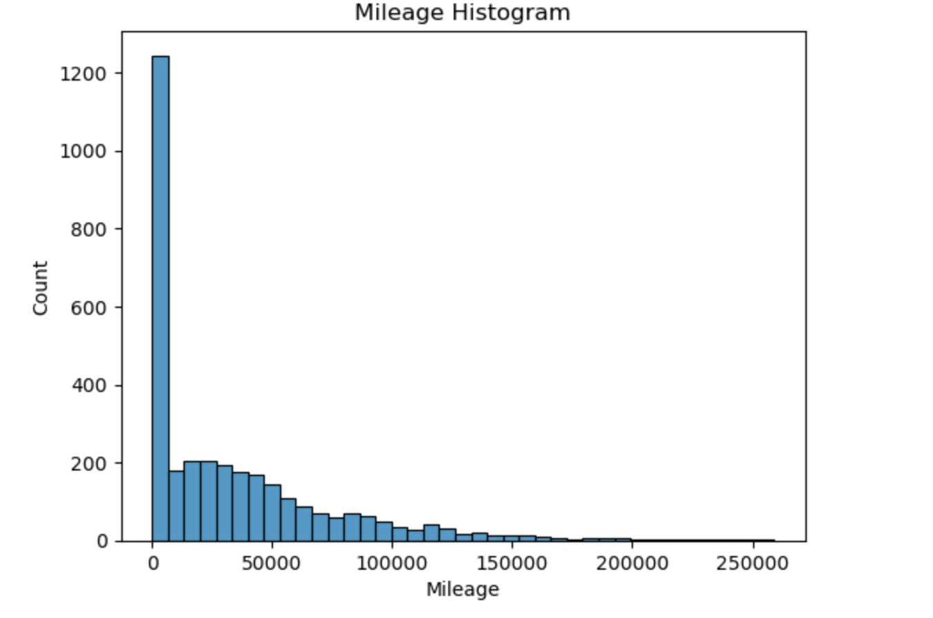
Mileage Count
Notes:
The mean mileage is 33,244 and the median is 20,363. Since many of the cars are new it is expected there will be a lot in first bin. There are also some cars with very high of mileage with the max being close to 260,000.

Slide 29
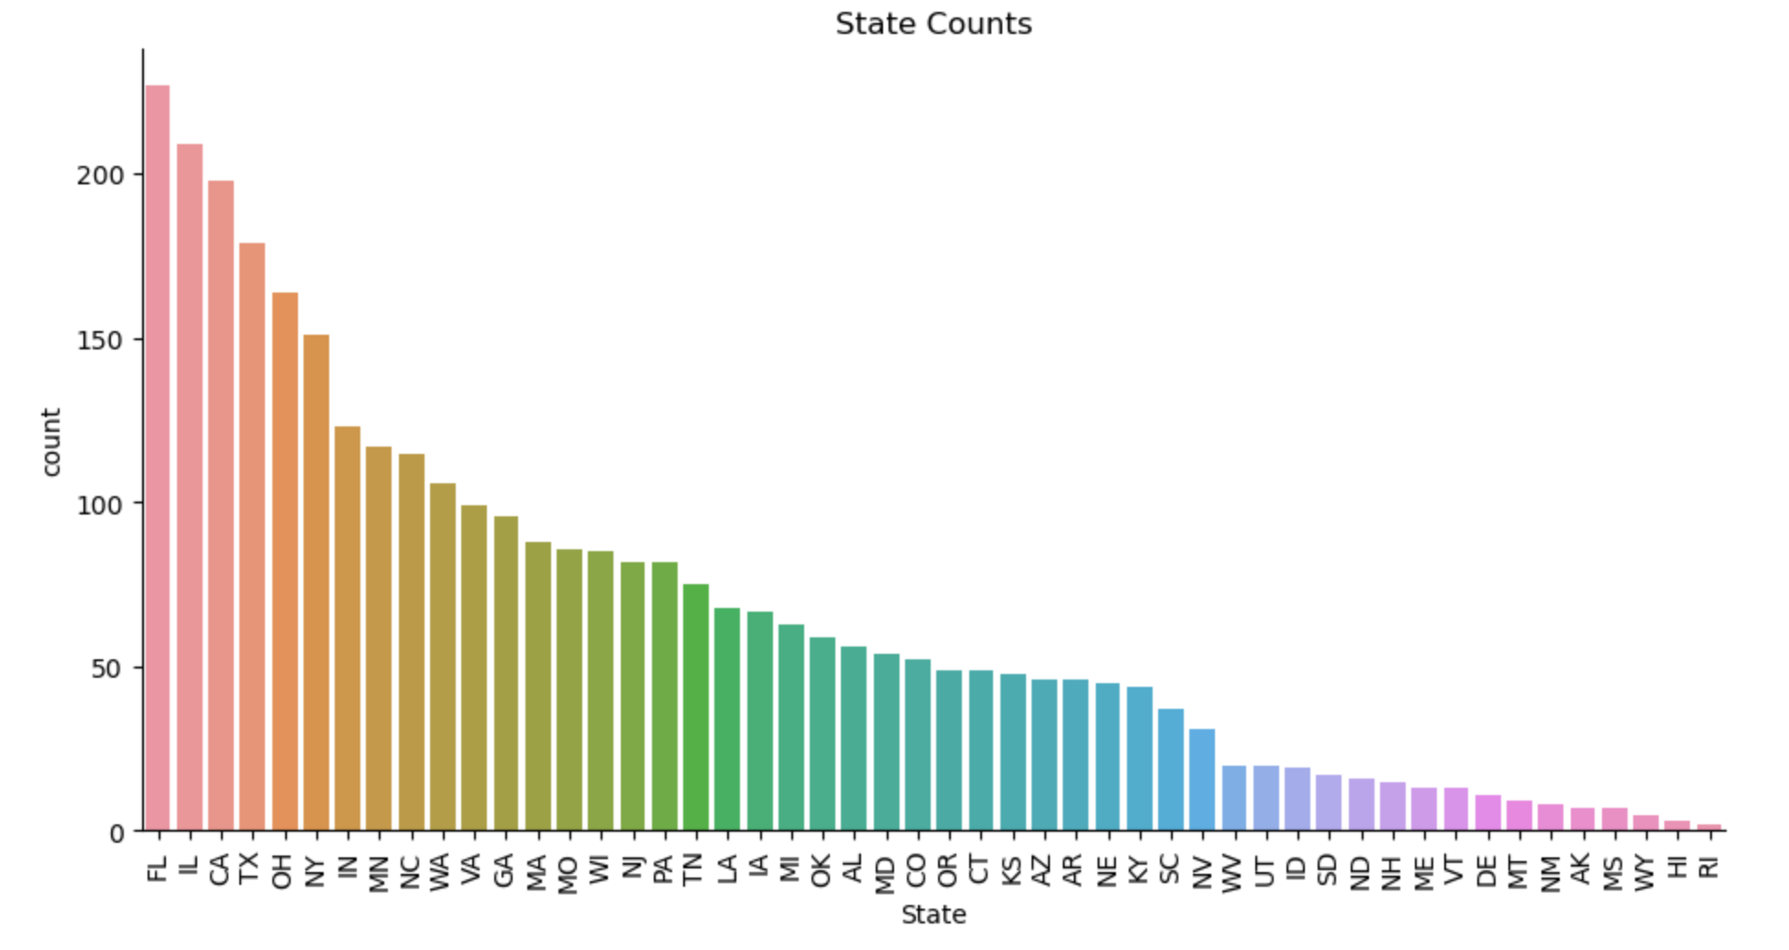
State Count
Notes:
This plot shows the number of cars in each state. Florida, Illinois, California, and Texas are at the top. Mississippi, Wyoming, Hawaii, and Rhode Island are at the low end.

Slide 30
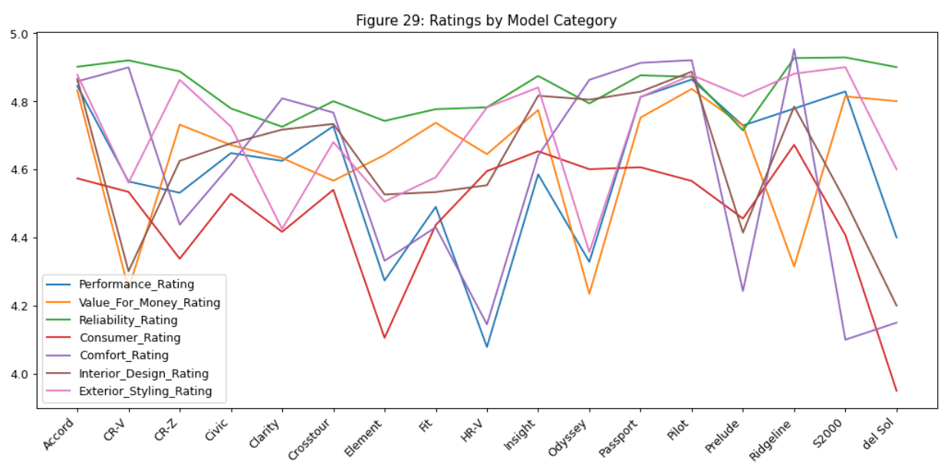
Ratings by Model
Notes:
Figure 29 shows a combination of ratings for each of the models. There is a generally high rating for reliability across the board. There are significant dips for the CR-V, Element, HR-V, Odyssey, Prelude, and Del Sol. The Ridgeline seems to have mostly high ratings with a dip only in the value for the money rating. The Pilot and Passport have the highest overall ratings.

Slide 31
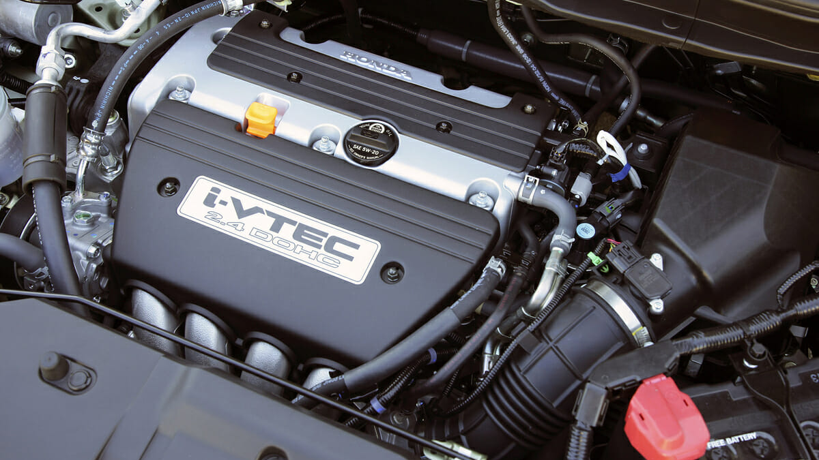
What car components are the key drivers of price points?

Slide 32
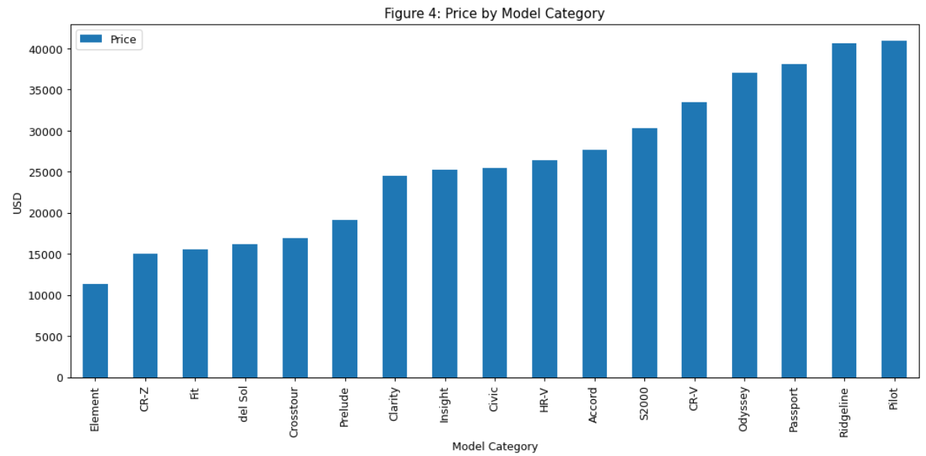
Price by Model
Notes:
Figure 4 begins by showing which brands command more value from customers. It’s not surprising to see larger vehicles with a higher price point and smaller vehicles with a lower price. The Element being the lowest cost is somewhat surprising in that it’s not a compact car but costs less than a CR-Z or a Del Sol which was last produced in 1998.

Slide 33
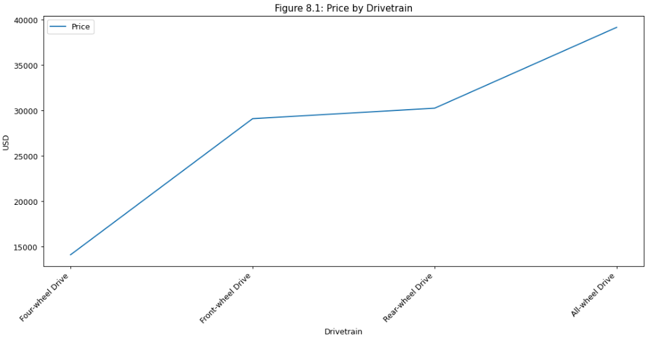
Price by Drivetrain
Notes:
Figure 8.1 shows the price premium for the engine drivetrain. The all-wheel drive vehicles demand the highest price. Front-wheel drive isn’t as costly as rear-wheel drive, but both are remarkably less expensive than front-wheel drive. This may be due to the specific models providing higher value to consumers for managing hard driving conditions like snow.

Slide 34
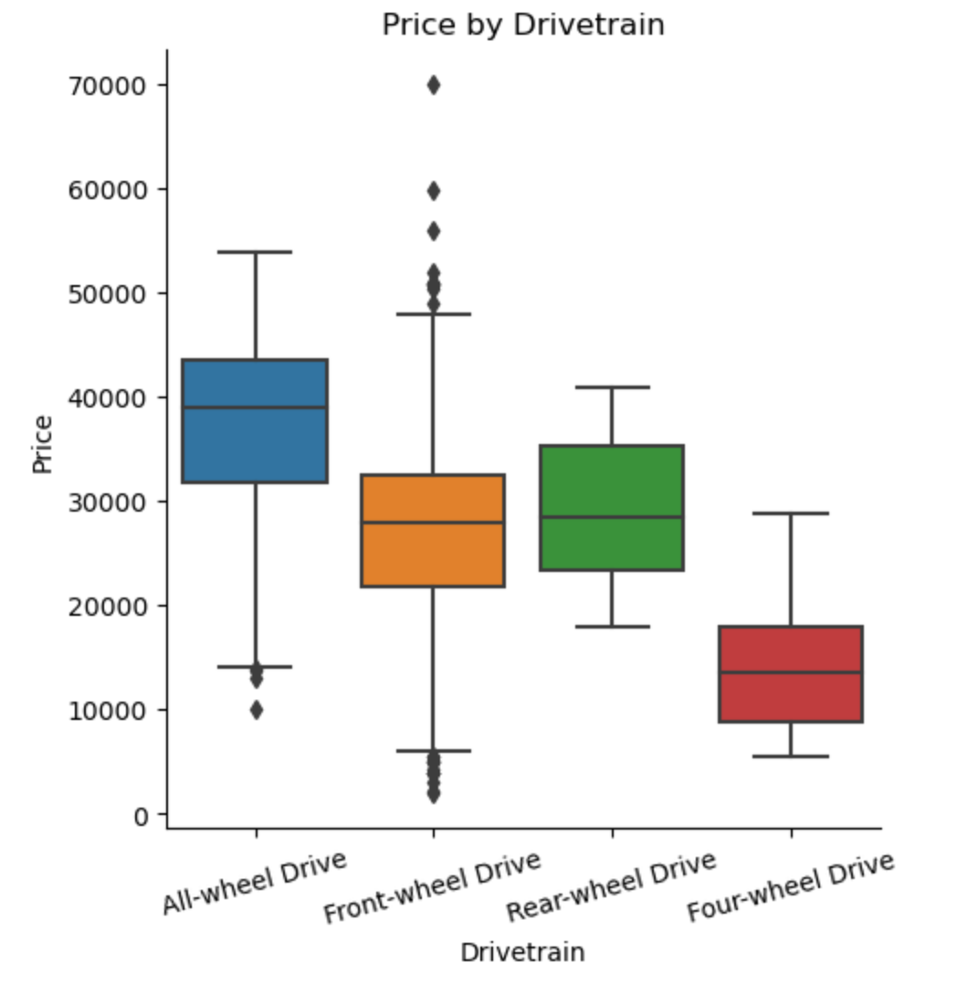
Price by Drivetrain
Notes:
Figure 8.1 shows the price premium for the engine drivetrain. The all-wheel drive vehicles demand the highest price. Front-wheel drive isn’t as costly as rear-wheel drive, but both are remarkably less expensive than front-wheel drive. This may be due to the specific models providing higher value to consumers for managing hard driving conditions like snow.

Slide 35
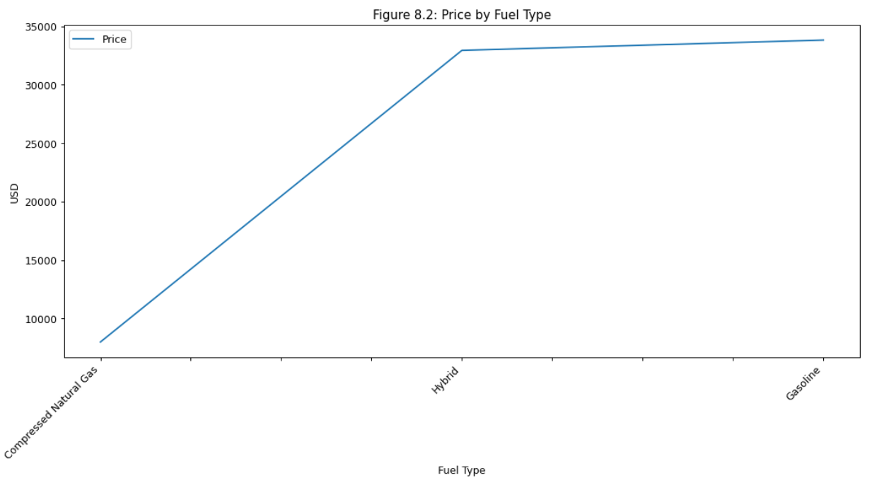
Price by Fuel Type
Notes:
Figure 8.2 shows that Compressed Natural Gas (CNG) engines do not hold a price premium. Gas and Hybrid engines hold a similar value, with Gas being slightly more expensive.

Slide 36
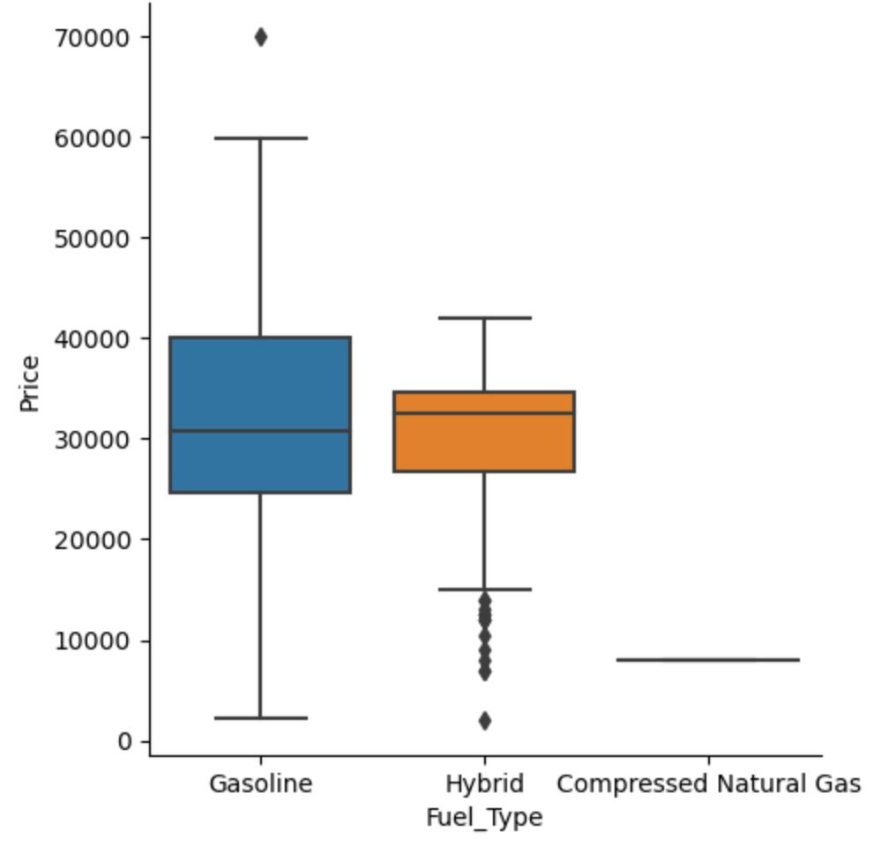
Price by Fuel Type
Notes:
Figure 8.2 shows that Compressed Natural Gas (CNG) engines do not hold a price premium. Gas and Hybrid engines hold a similar value, with Gas being slightly more expensive.

Slide 37
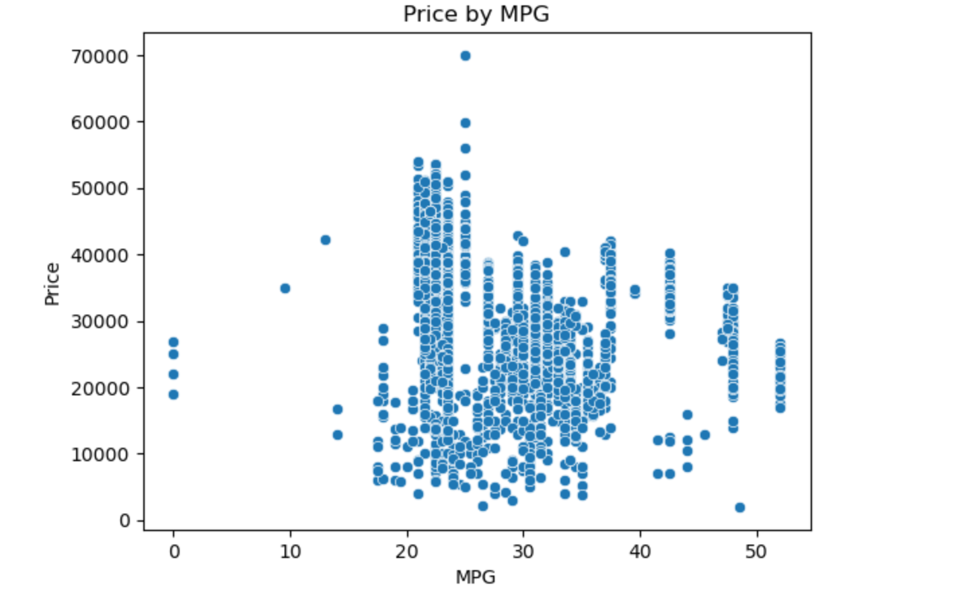
Price by MPG

Slide 38
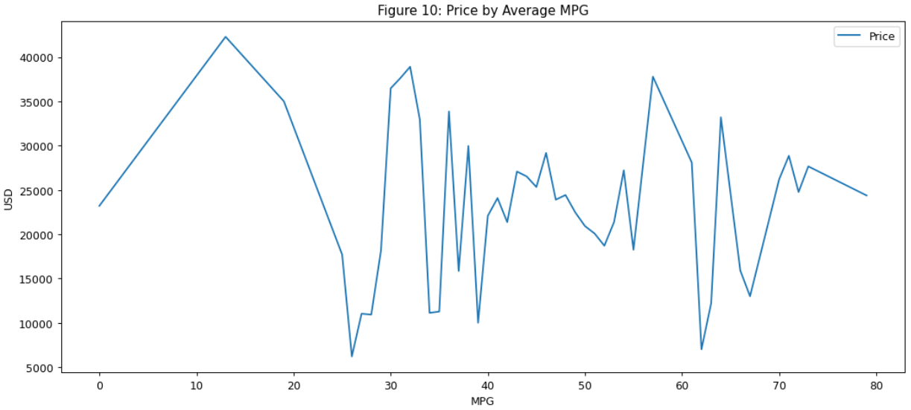
Price by Average MPG
Notes:
Figure 10 shows the average price against the average miles per gallon. I would expect to see a positive correlation between price and mpg, but there doesn’t appear to be. There may even be a somewhat negative correlation which is unexpected. This could be accounted for by larger gas vehicles commanding a higher price and smaller, more efficient vehicles having better gas mileage at an affordable price.

Slide 39
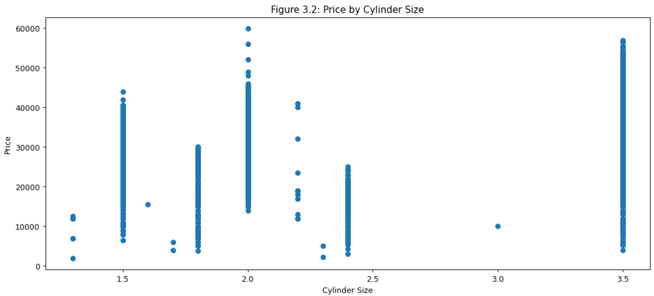
Price by Cylinder Size
Notes:
shows an even split among the data between the 4 and 6-cylinder engines. Both are common engine configurations.

Slide 40

Price by Year
Notes:
shows that prices have a positive correlation with newer models. This isn’t surprising at all. What is interesting are the oldest cars. There are six built prior to 1995 whose price seems to stay high despite their age. Four of them are Preludes. The other two are a Del Sol and a Civic.

Slide 41

Price by Condition
Notes:
Figure 8.3 shows the price range for car conditions. It’s not a surprise that used cars are the least valued, with Honda Certification above it but below a new car value.

Slide 42

Price by Transmission
Notes:
Figure 8.4 shows a trend of increasing price with more gears, with a notable exception of the Continuously Variable Transmission (CVT,) which is a high-performing all-in-one gear with a mid-range price.

Slide 43

Price by Exterior Color
Notes:
Figure 8.5 shows that Tan, Gold, and Brown are at the lowest end of the pricing range, while Gray, Black, Red, and White are at the top. Yellow is an anomaly with a price point premium of $20,000.

Slide 44

Price by Mileage
Notes:
Figure 11 shows a very strong correlation between miles driven and price. Price favors the newer cars.

Slide 45

Price by State
Notes:
Figure 7 now focuses on the average price by state. Most states show a trend of roughly $32,000 for a vehicle, with two notable exceptions. Rhode Island has the lowest average selling price at $20,000, while Delaware has the highest average price above $40,000.

Slide 46

Average MPG by State
Notes:
Figure 14 shows the average miles per gallon (MPG) by state. California has reasonably moderate MPG indicating that those prices may afford better overall car economy. Delaware has the lowest MPG. Combine that with the highest average car prices, and Delaware seems to be quite expensive to own a Honda.

Slide 47

Larger Models (SUV)
2 and 3.5 Liter engines
6 cylinder engines
More Valves / Gears
A Gas Direct Injection (GDI)
Lower mileage / Newer car
All-wheel drive
Interestingly yellow paint job
Price Mechanics

Slide 48

“A Company is most clearly defined not by its people,
or its history,
but by its products.”
– Soichiro Honda

